Slide 1
The African Monsoon Recent Evolution and Current Status Include Week-1 and Week-2 Outlooks
Update prepared by
1 November 2021
For more information, visit:
http://www.cpc.ncep.noaa.gov/products/Global_Monsoons/African_Monsoons/precip_monitoring.shtml

Slide 2
Outline
Highlights
Recent Evolution and Current Conditions
NCEP GEFS Forecasts
Summary

Slide 3
Highlights: Last 7 Days
During the past 7 days, local areas in western Guinea, Gabon, and central Congo received heavy rainfall amounts of over 150 mm (more than 100 mm above the mean).
The week-1 outlooks depict an increased chance for above-average rainfall across Sierra Leone, Liberia, Cameroon, Gabon, eastern South Africa, Lesotho and Swaziland. Conversely, there is an increased chance for below-average rainfall across southeast South Sudan, Uganda, southern Ethiopia, Kenya, Somalia, Zambia, southern DR Congo, northeastern Botswana, Zimbabwe, Mozambique and Madagascar.
The week-2 outlooks call for an increased chance for below-average rainfall across Sierra Leone, Liberia, Cameroon, Gabon, Congo, eastern South Africa, Lesotho and Swaziland. There is an increased chance for below-average rainfall across southwestern Ethiopia, eastern South Sudan, eastern DR Congo, Uganda, western Kenya, northern Tanzania, Zambia, southern DR Congo, northeastern Botswana, Zimbabwe, Mozambique and Madagascar.

Slide 4
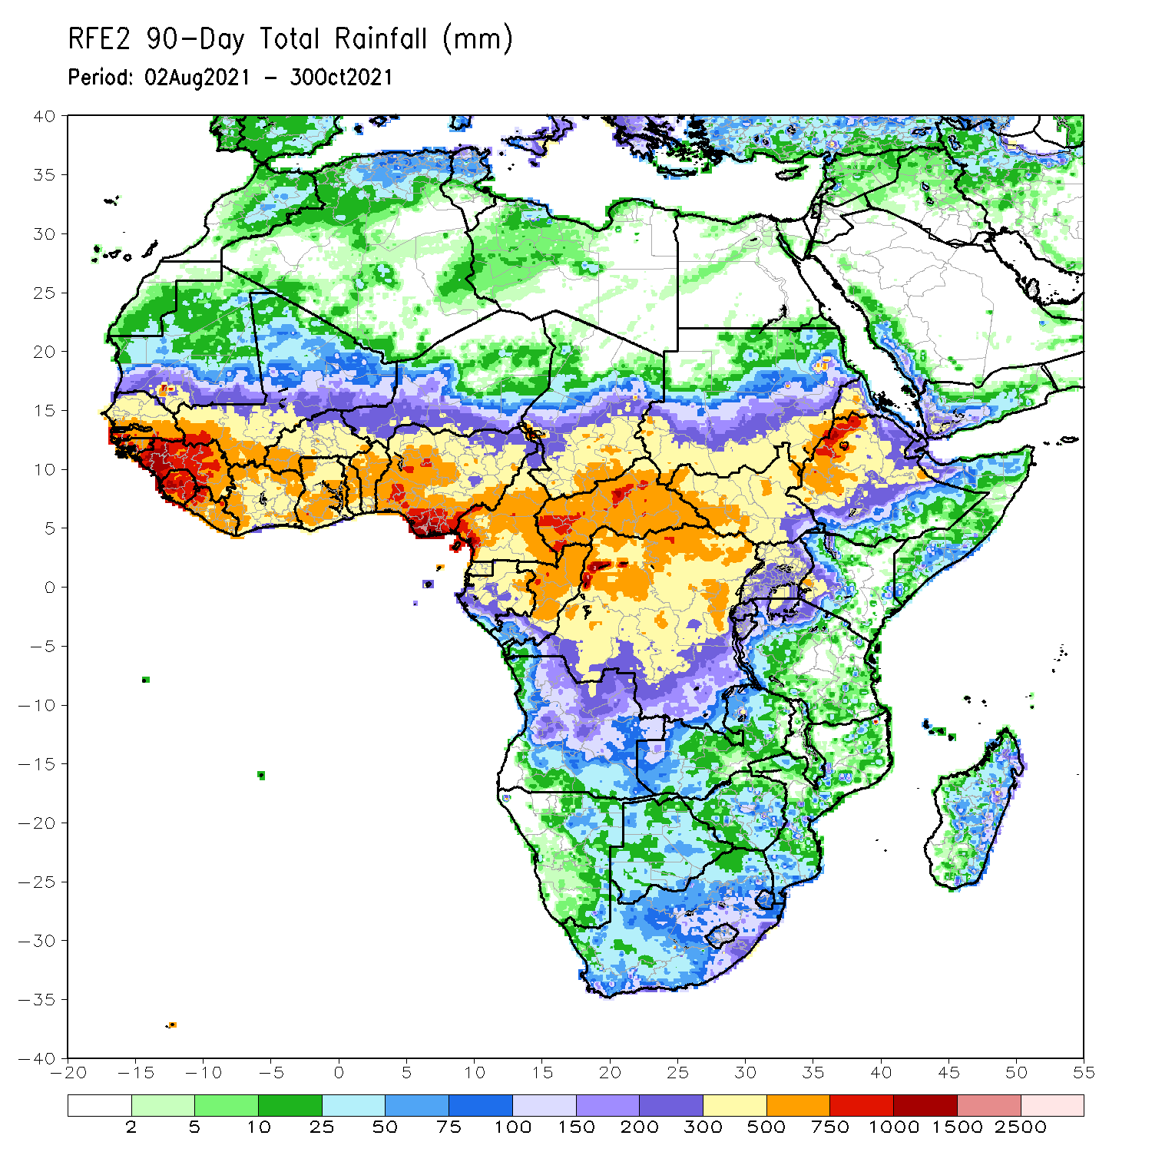
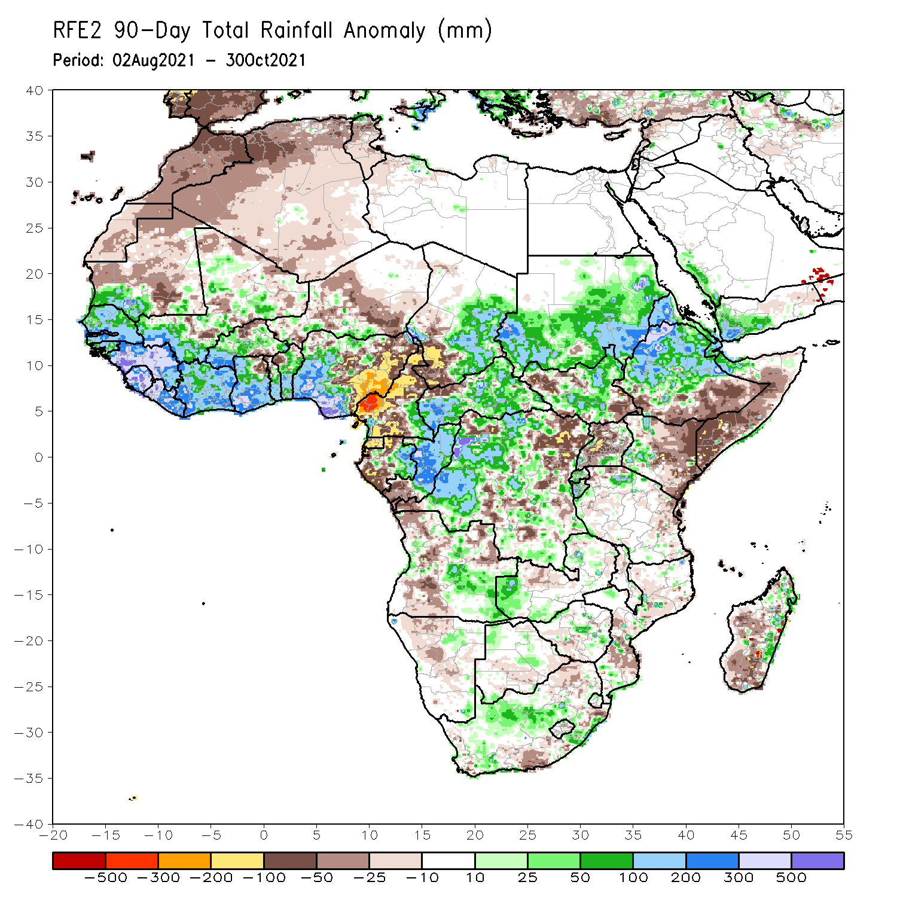
Rainfall Patterns: Last 90 Days
Over the past 90 days, in West Africa, moisture surpluses of over 300 mm were observed across southwestern Mali, Guinea, Sierra Leone, northern Liberia, southern Côte d’Ivoire, southern Ghana, and portions of southern Nigeria. Positive precipitation anomalies of over 500 mm were found across local areas in Guinea, Sierra Leone, northern Liberia, and southern Nigeria. Conversely, central and eastern Nigeria experienced moisture deficits of over 100 mm.
In Central Africa, precipitation was well above-average across western and eastern Chad, much of CAR, southeastern Cameroon, eastern Gabon, much of Congo, and portions of DRC (positive precipitation anomalies of over 100 mm). Below-average precipitation conditions (more than 100 mm below the mean) were found across southwestern Chad, many parts of Cameroon, Equatorial Guinea, western Gabon, and northeastern DRC. Large moisture deficits of over 300 mm were observed in western Cameroon.
In East Africa, northwestern Ethiopia received heavy rainfall amounts of over 750 mm (more than 300 mm above the mean). Heavy rainfall was also found over Sudan, parts of South Sudan, western Eritrea, northern Ethiopia, and northern Somalia. Negative precipitation anomalies of over 50 mm were observed over portions of South Sudan, southern Ethiopia, Uganda, much of Kenya and Somalia.
In Southern Africa, local areas in Angola, Zambia, Zimbabwe, South Africa, and eastern Madagascar registered heavy rainfall (more than 100 mm above the mean).
Notes:
4

Slide 5
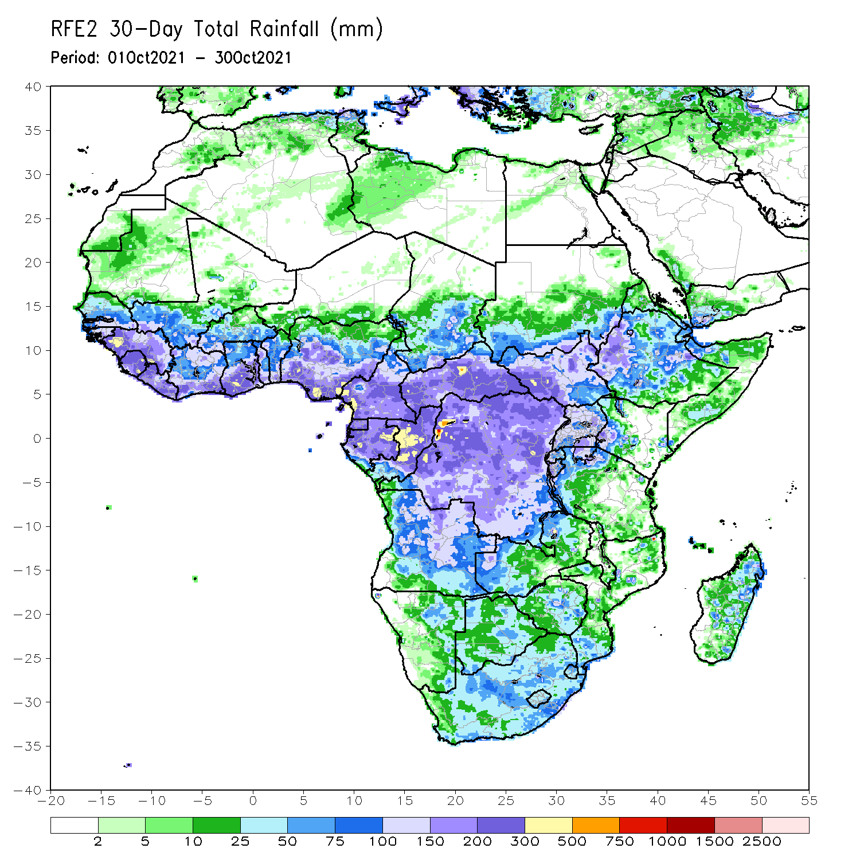
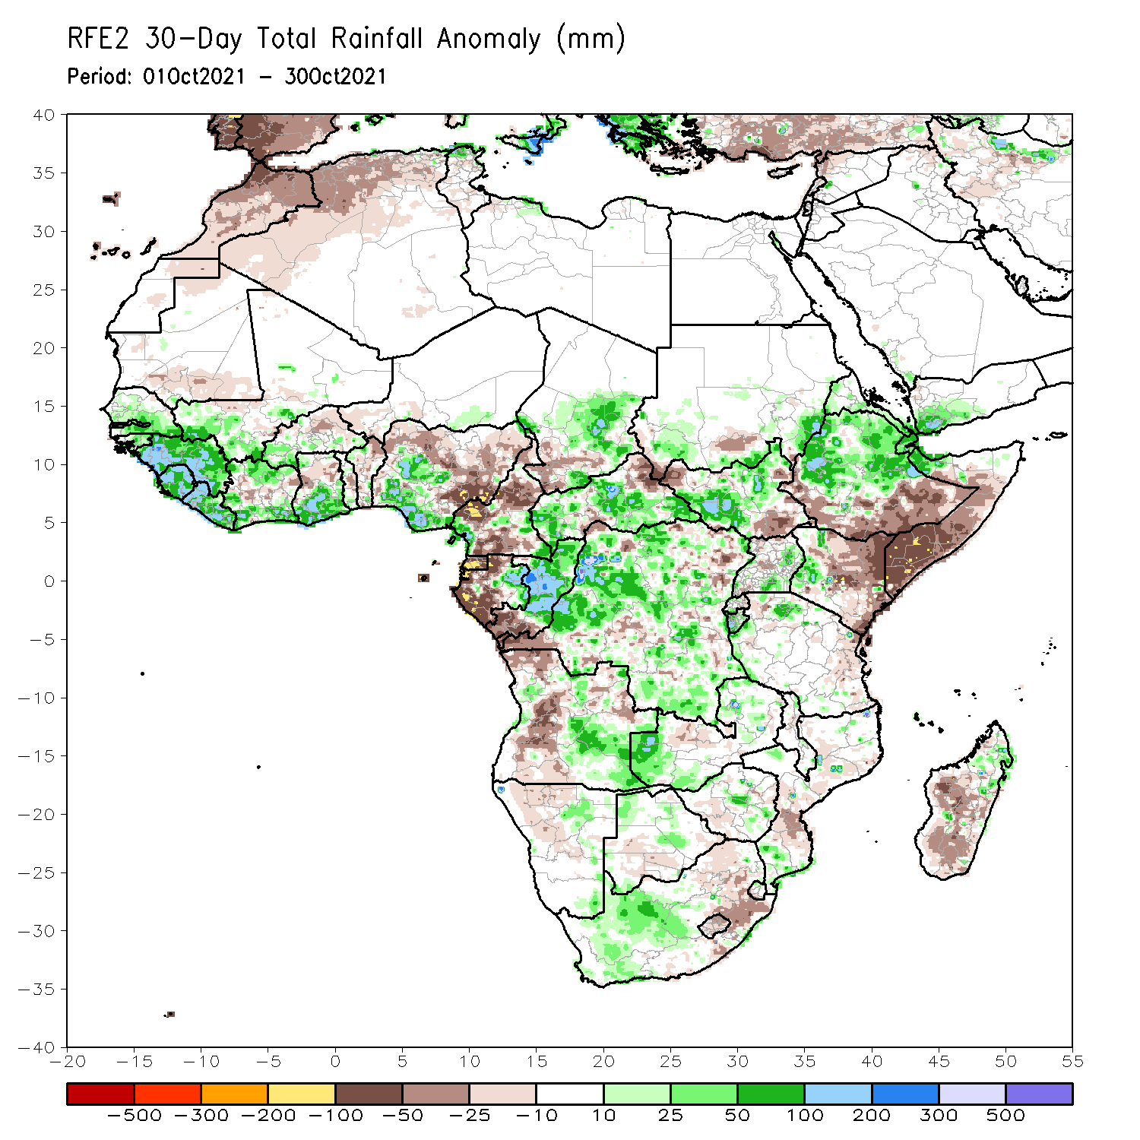
Rainfall Patterns: Last 30 Days
During the past 30 days, in West Africa, rainfall totals exceeding 200 mm led to moisture surpluses of over 100 mm across Guinea, Sierra Leone, Liberia, southern Côte d’Ivoire, southern Ghana, and parts of Nigeria. Moisture deficits of over 100 mm were observed across eastern Nigeria.
In Central Africa, precipitation was 100 mm above the mean across local areas in western and central Chad, portions of CAR, eastern Gabon, Congo, and western DRC. Below-average precipitation prevailed in northeastern CAR, Cameroon, Equatorial Guinea, western Gabon, and southern Congo. Western Cameroon (more than 50 mm below the mean), Western Cameron, Equatorial Guinea, and western Gabon experienced negative precipitation anomalies of over 100 mm.
In East Africa, moisture surpluses of over 100 mm were found across local areas in eastern Sudan, South Sudan, northern Ethiopia, and western Kenya. Moisture deficits of over 50 mm were observed over northwestern and southeastern South Sudan, southern Ethiopia, eastern Kenya, and southern Somalia.
In Southern Africa, northern and central Angola and western Zambia registered rainfall amounts of over 150 mm (more than 50 mm above the mean).
Notes:
5

Slide 6
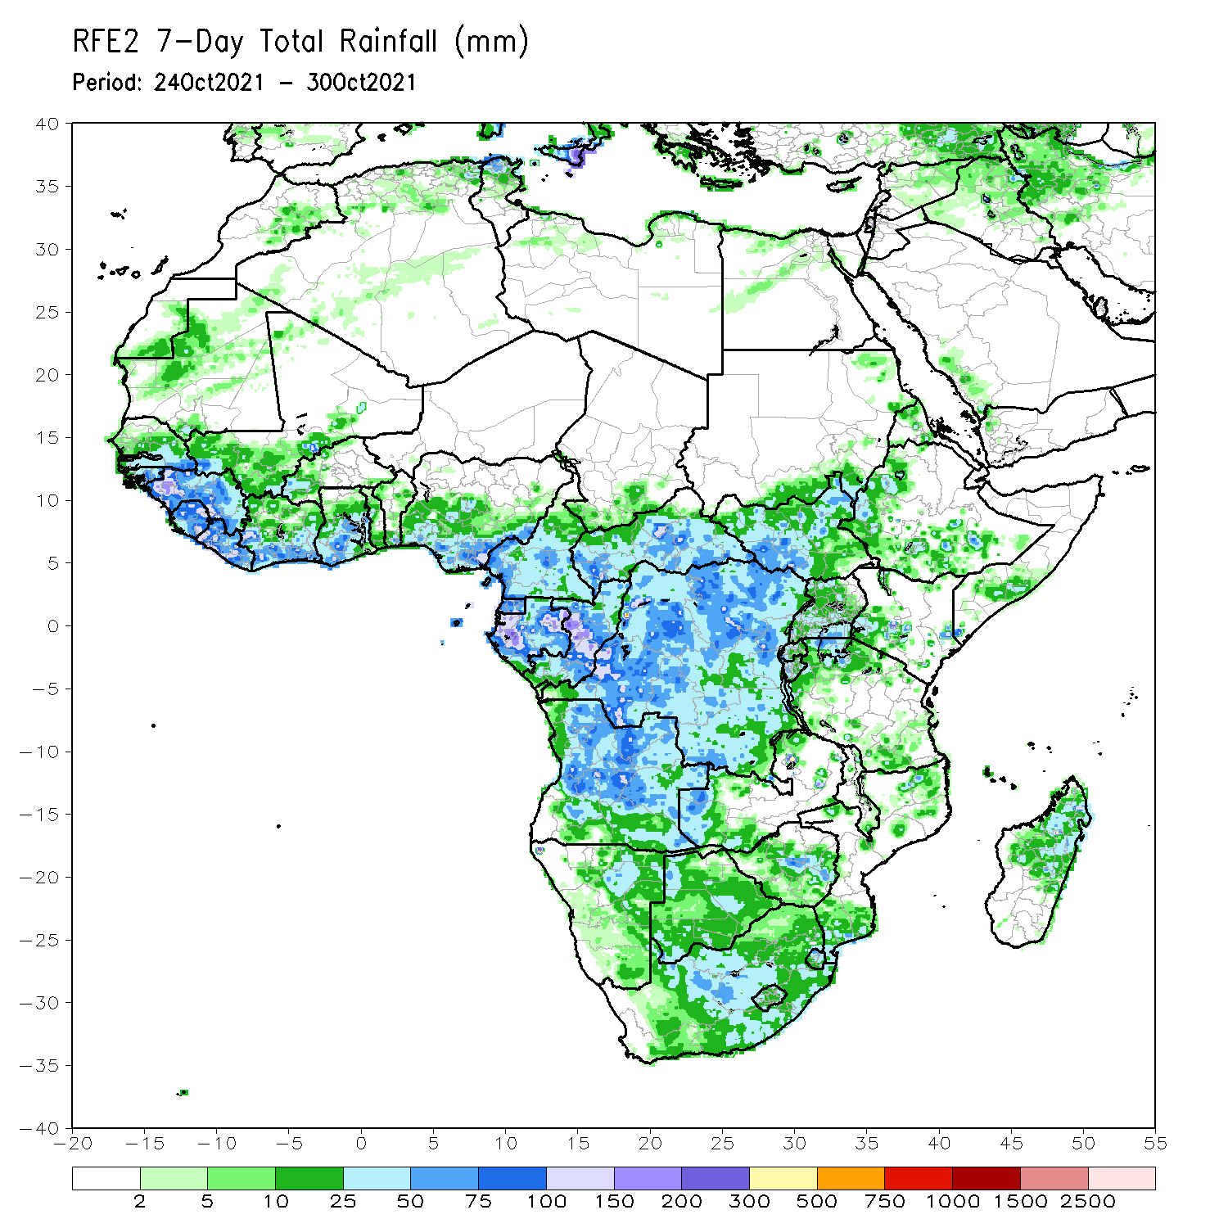
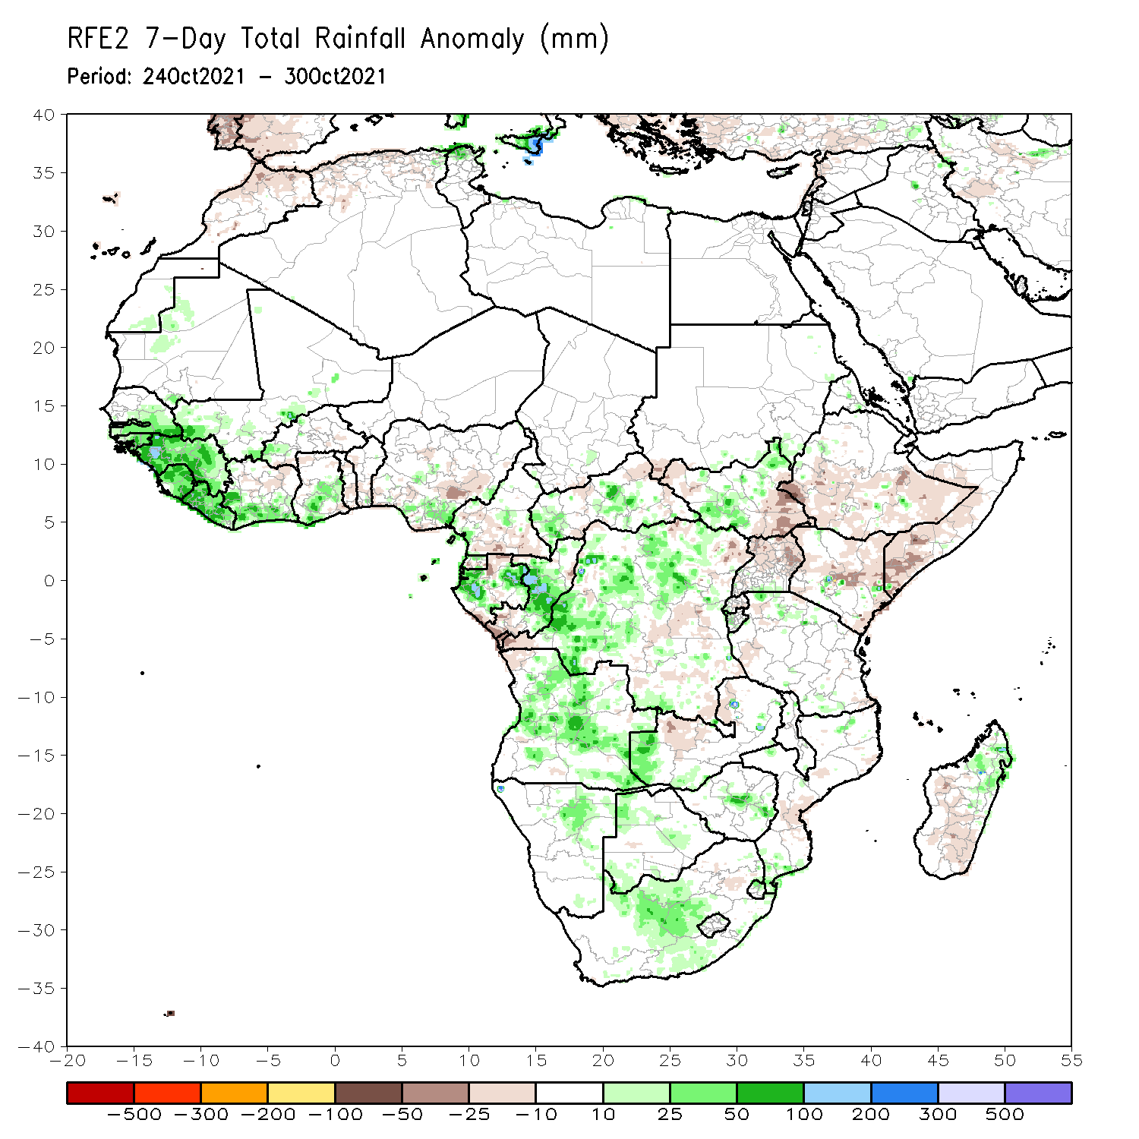
Rainfall Patterns: Last 7 Days
During the past 7 days, in West Africa, southern Senegal, southwestern Mali, Guinea-Bissau, Guinea, Sierra Leone, Liberia, southern Côte d’Ivoire, and southern Ghana experienced above-average rainfall, with moisture surpluses of over 50 mm. Local areas in western Guinea registered rainfall amounts of 150-200 mm (more than 100 mm above the mean).
In Central Africa, local areas in Gabon, central Congo, and western DRC received precipitation totals of over 150 mm (more than 100 mm above the mean). Precipitation was above-average across portions of CAR and much of DRC.
In East Africa, Ethiopia, western and eastern CAR, Uganda, Uganda, Kenya, and Somalia experienced light moisture deficits of 10-25 mm. Conversely, central South Sudan experienced above-average rainfall, with moisture surpluses of over 25 mm.
In Southern Africa, positive precipitation anomalies of over 25 mm were found across Angola, western Zambia, eastern Namibia, Botswana, South Africa, southern Mozambique, and northern Madagascar.

Slide 7
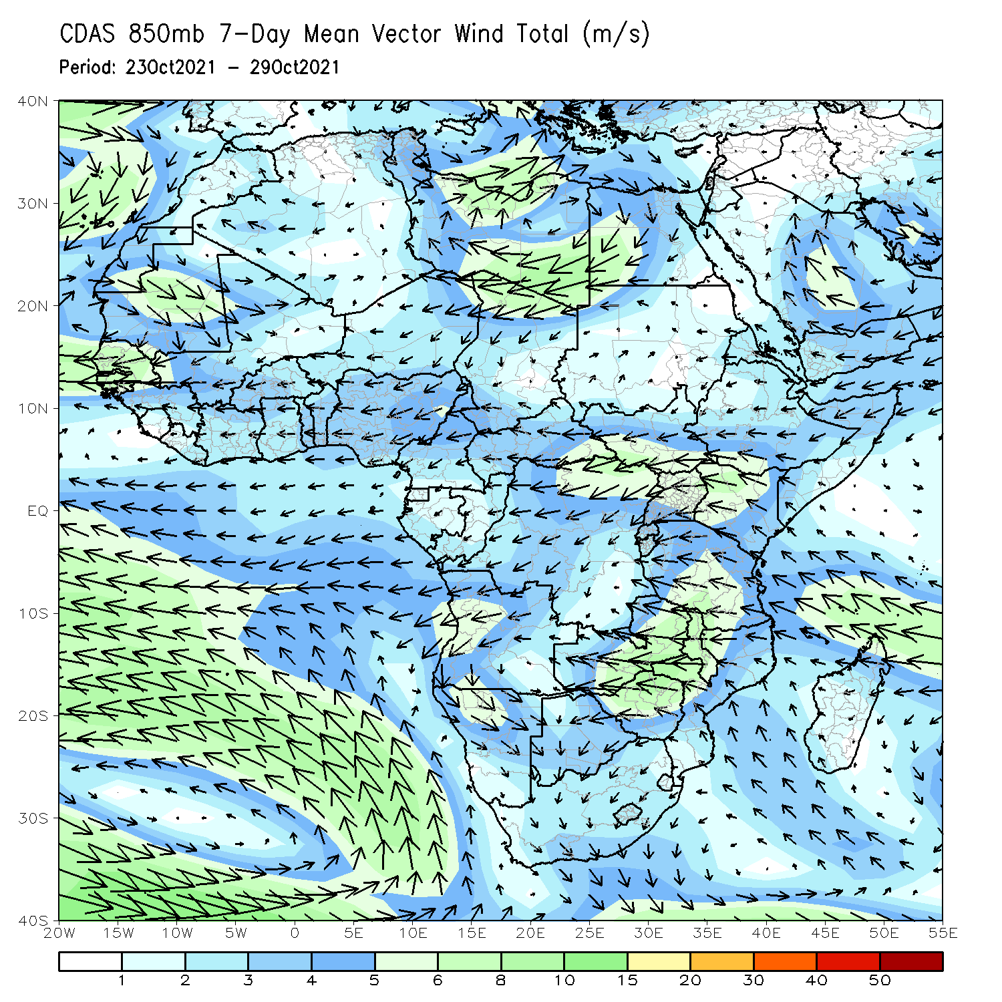
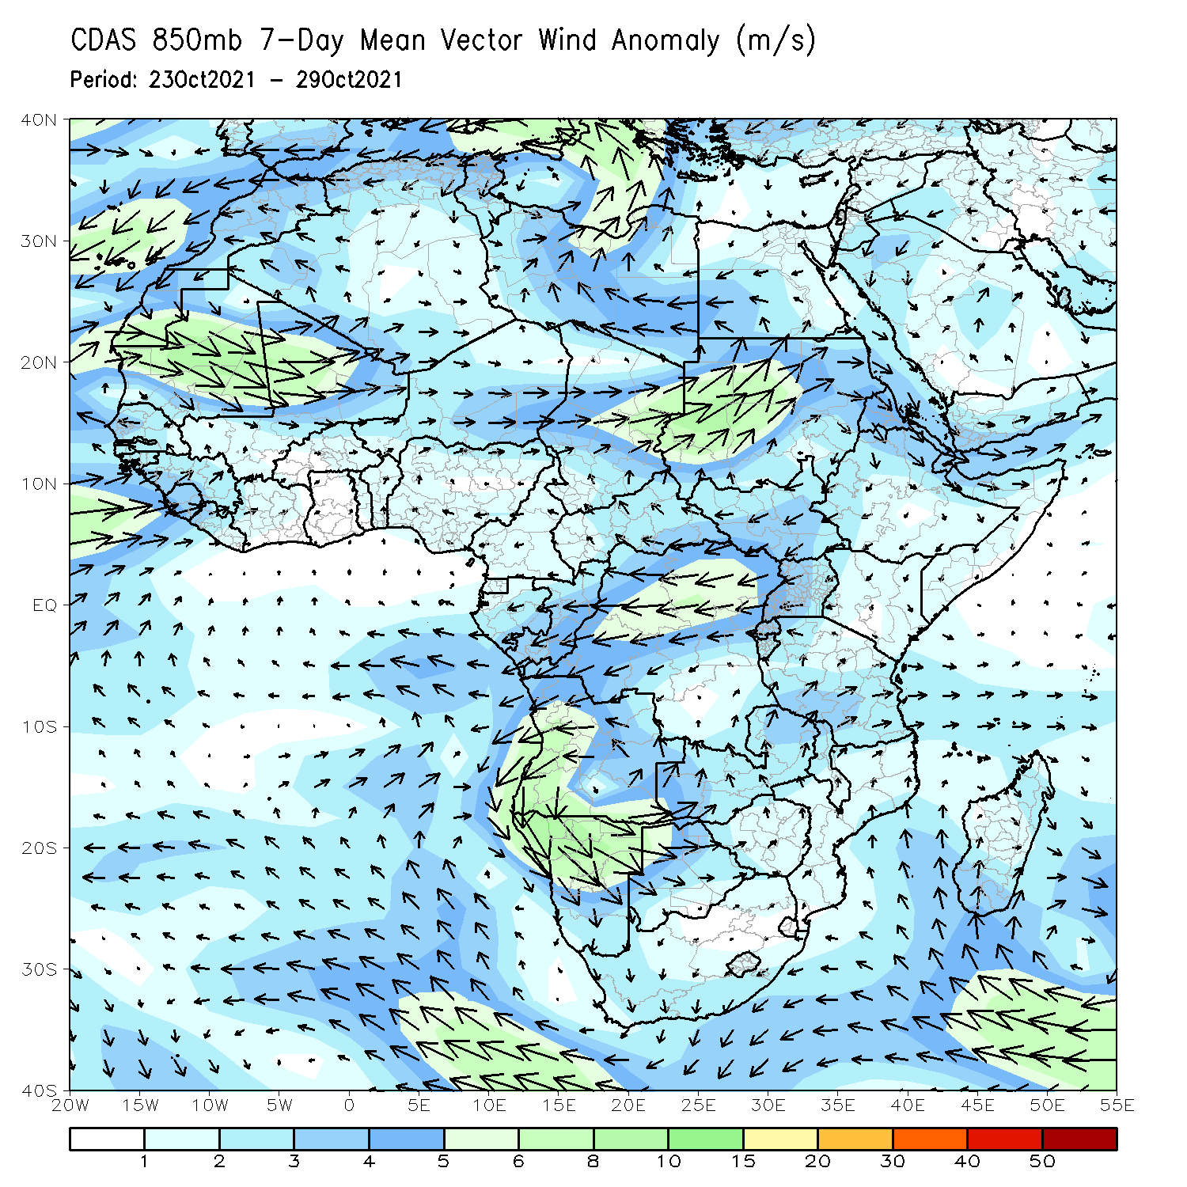
Atmospheric Circulation: Last 7 Days
The 850-hPa atmospheric circulation pattern features an anomalous cyclonic circulation that may have contributed to enhanced rainfall in Senegal, Guinea-Bissau, Guinea, Sierra Leone, Liberia, and portions of Côte d’Ivoire.
A strong cyclonic circulation was present over Angola. This may have led to enhanced rainfall in this region.

Slide 8
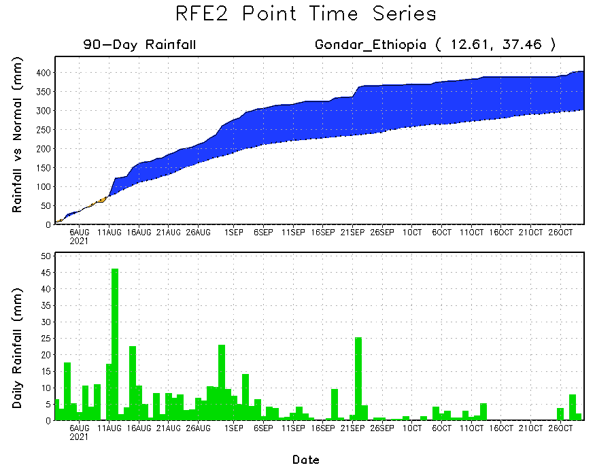
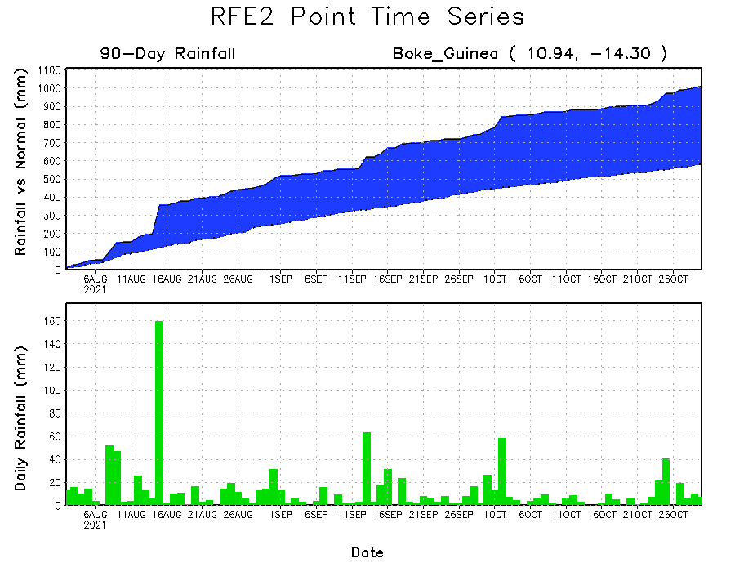
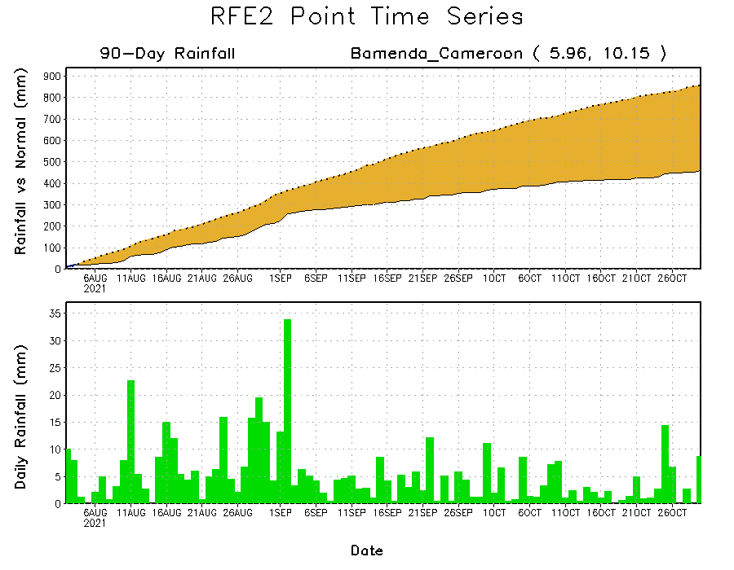
Rainfall Evolution
Daily evolution of rainfall over the last 90 days at selected locations shows sustained moisture surpluses over Guinea (bottom left) and northwestern Ethiopia (top right). In contrast, seasonal total rainfall remained below-average over southwestern Cameroon despite recent rainfall (bottom right).

Slide 9
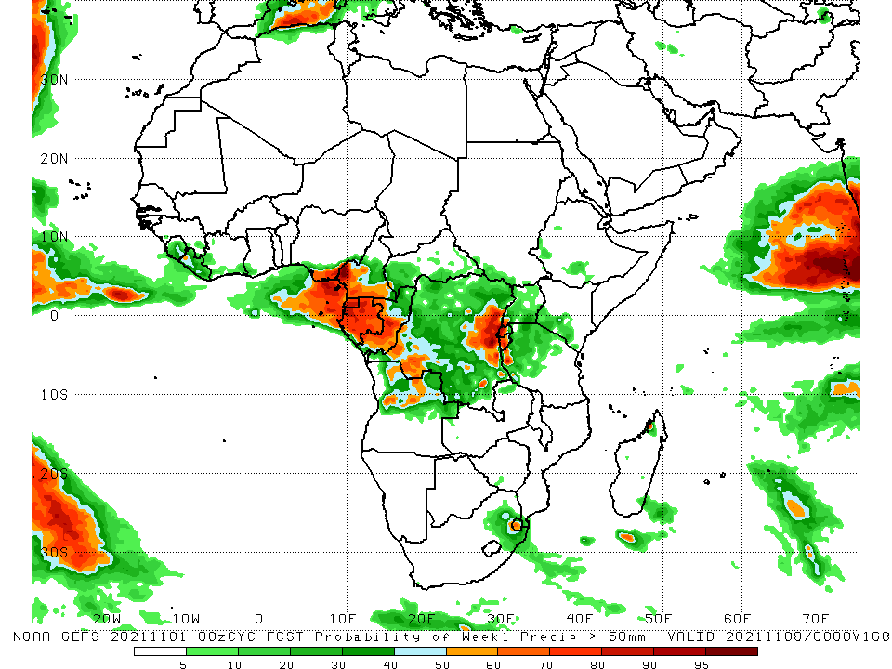
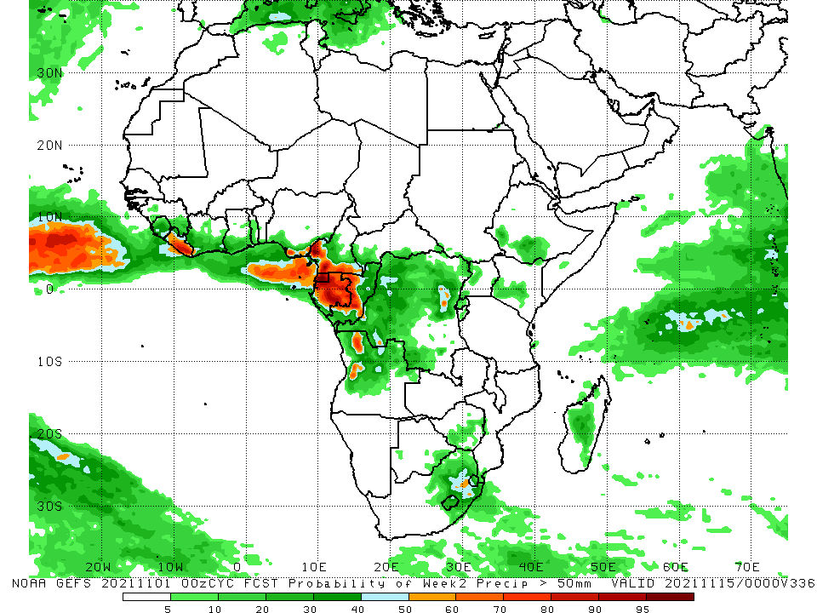
NCEP GEFS Model Forecasts Non-Bias Corrected Probability of precipitation exceedance
Week-1, Valid: 2 – 8 November 2021
Week-2, Valid: 9 – 15 November 2021
For week-1 (left panel) and week-2 forecast (right panel), the NCEP GEFS forecasts indicate a moderate to high chance (over 70%) for rainfall to exceed 50 mm over portions of Liberia, southern Nigeria, western Cameroon, Equatorial Guinea, Gabon, Congo, northern Angola, and Eswatini.
In addition, the week-2 forecast indicates an increased chance (over 70%) for weekly rainfall to exceed 50 mm across western and eastern DRC, southwestern Uganda, Rwanda, and Burundi.
Notes:
9

Slide 10
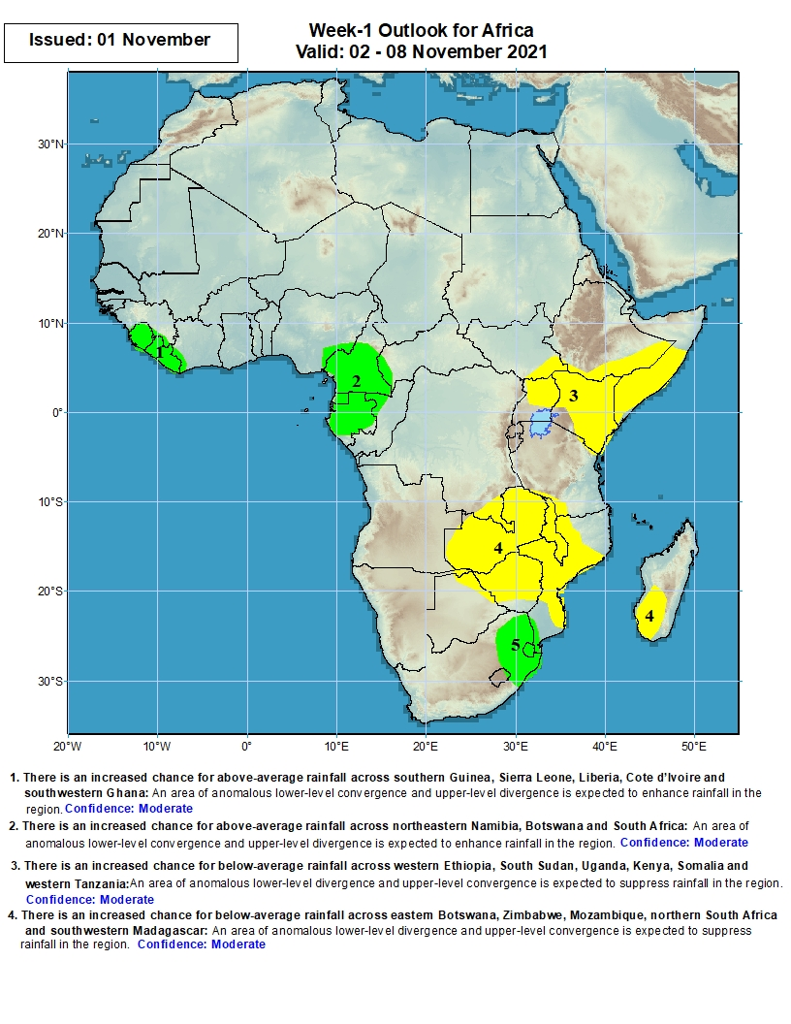
Week-1 Precipitation Outlooks
2 – 8 November 2021
There is an increased chance for above-average rainfall across Sierra Leone and Liberia: An area of anomalous lower-level convergence and upper-level divergence is expected to enhance rainfall in the region. Confidence: Moderate
There is an increased chance for above-average rainfall across Cameroon and Gabon: An area of anomalous lower-level convergence and upper-level divergence is expected to enhance rainfall in the region. Confidence: Moderate
There is an increased chance for below-average rainfall across southeast South Sudan, Uganda, southern Ethiopia, Kenya and Somalia: An area of anomalous lower-level divergence and upper-level convergence is expected to suppress rainfall in the region. Confidence: Moderate
There is an increased chance for below-average rainfall across Zambia, southern DR Congo, northeastern Botswana, Zimbabwe, Mozambique and Madagascar: An area of anomalous lower-level divergence and upper-level convergence is expected to suppress rainfall in the region. Confidence: Moderate
There is an increased chance for above-average rainfall over eastern South Africa, Lesotho and Swaziland: An area of anomalous lower-level convergence and upper-level divergence is expected to enhance rainfall in the region. Confidence: Moderate
Notes:
10

Slide 11
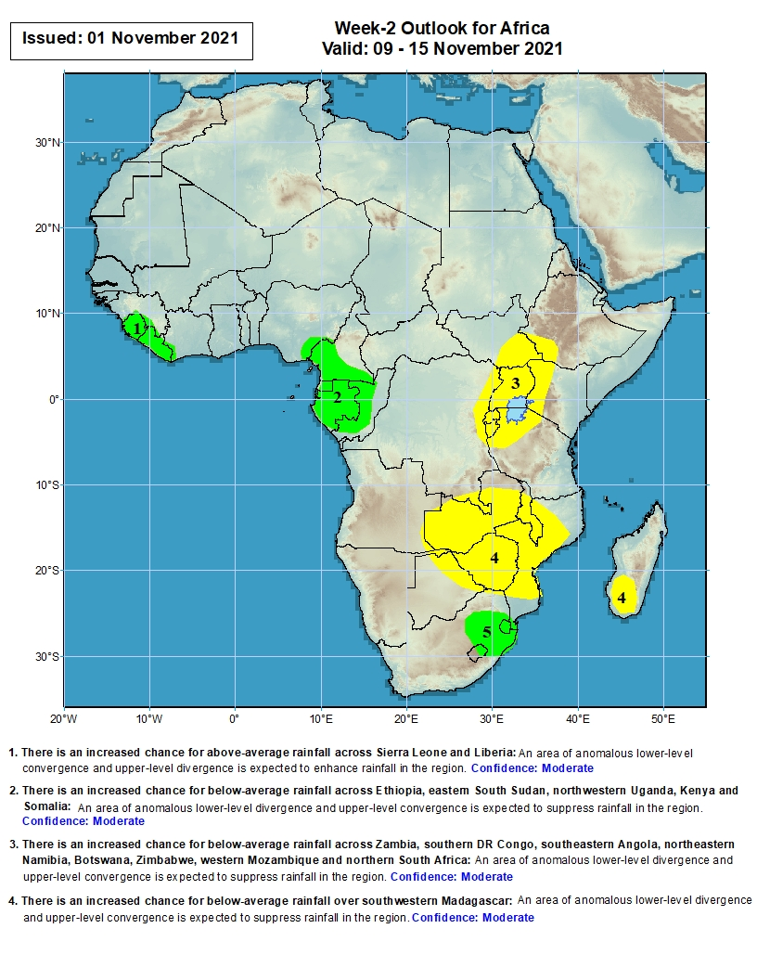
Week-2 Precipitation Outlooks
9 – 15 November 2021
There is an increased chance for above-average rainfall across Sierra Leone and Liberia: An area of anomalous lower-level convergence and upper-level divergence is expected to enhance rainfall in the region. Confidence: Moderate
There is an increased chance for above-average rainfall across Cameroon, Gabon and Congo: An area of anomalous lower-level convergence and upper-level divergence is expected to enhance rainfall in the region. Confidence: Moderate
There is an increased chance for below-average rainfall across southwestern Ethiopia, eastern South Sudan, eastern DR Congo, Uganda, western Kenya and northern Tanzania: An area of anomalous lower-level divergence and upper-level convergence is expected to suppress rainfall in the region. Confidence: Moderate
There is an increased chance for below-average rainfall across Zambia, southern DR Congo, northeastern Botswana, Zimbabwe, Mozambique and Madagascar: An area of anomalous lower-level divergence and upper-level convergence is expected to suppress rainfall in the region. Confidence: Moderate
There is an increased chance for above-average rainfall over eastern South Africa, Lesotho and Swaziland: An area of anomalous lower-level convergence and upper-level divergence is expected to enhance rainfall in the region. Confidence: Moderate
Notes:
11

Slide 12
Summary
During the past 30 to 90 days, in West Africa, southern Senegal, southwestern Mali, southwestern Burkina Faso, Guinea, Sierra Leone, Liberia, northern and southern Côte d’Ivoire, southern Ghana, and central and southwestern Nigeria observed above-average rainfall. Eastern Nigeria continued to experience negative precipitation anomalies. In Central Africa, moisture surpluses were found across eastern Chad, much of CAR, much of Congo, and many parts of DRC. Moisture deficits were found across southwestern Chad, Cameroon, Equatorial Guinea, western Gabon, and southern Congo. In East Africa, above-average rainfall prevailed in Eritrea, northern Ethiopia, northern Somalia, and much of South Sudan. Southern Ethiopia, Kenya, and southern Somalia observed below-average rainfall. Eastern Angola, western Zambia, portions of South Africa, and eastern Madagascar experienced moisture surpluses.
During the past 7 days, in West Africa, southern Senegal, Guinea-Bissau, Guinea, Sierra Leone, Liberia, southern Côte d’Ivoire, southern Ghana, and southern Nigeria received above-average rainfall. Moisture surpluses of over 100 mm were found across local areas in western Guinea, Gabon, central Congo, and western DRC. In East Africa, below-average rainfall conditions prevailed in the Greater Horn of Africa, except across central South Sudan. In Southern Africa, Angola, western Zambia, western Namibia, Botswana, Zimbabwe, South Africa, southern Mozambique, and northern Madagascar experienced above-average rainfall.
The week-1 outlooks depict an increased chance for above-average rainfall across Sierra Leone, Liberia, Cameroon, Gabon, eastern South Africa, Lesotho and Swaziland. Conversely, there is an increased chance for below-average rainfall across southeast South Sudan, Uganda, southern Ethiopia, Kenya, Somalia, Zambia, southern DR Congo, northeastern Botswana, Zimbabwe, Mozambique and Madagascar.
The week-2 outlooks call for an increased chance for below-average rainfall across Sierra Leone, Liberia, Cameroon, Gabon, Congo, eastern South Africa, Lesotho and Swaziland. There is an increased chance for below-average rainfall across southwestern Ethiopia, eastern South Sudan, eastern DR Congo, Uganda, western Kenya, northern Tanzania, Zambia, southern DR Congo, northeastern Botswana, Zimbabwe, Mozambique and Madagascar.

